Slide 1
CALIFORNIA DEPARTMENT OF INSURANCE
Mary Beth Bykowsky
Community Relations & Outreach Branch

Slide 2
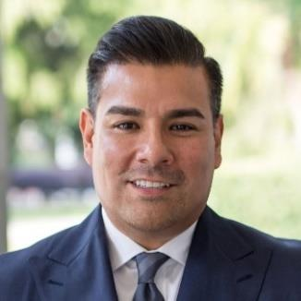
How the Department of Insurance protects Californians
Protect consumers from fraud and abuse
Regulate most lines of insurance and maintain insurer solvency
Set standards for agents and broker licensing
Perform market conduct reviews of insurance companies
Resolve consumer insurance complaints

Slide 3
What Seniors Need to Know
Seniors are the largest population targeted for scams
Why are seniors big targets?

Slide 4
Common Insurance Scams

Slide 5
Annuities
What is it?
Is it RIGHT for you?
Pros
Cons

Slide 6
Insurance Scam Warning Signs
The agent
offers “free” seminars
offers “free” meals
offers to create or update a living trust
gives you wrong information about your current investments
Senior Insurance Bill of Rights (SIBOR)

Slide 7
Avoid Becoming a Victim
Check the status of insurance agent/insurance company
Answer all questions thoroughly and truthfully
Get everything in writing and compare policies
ASK QUESTIONS
Never feel pressured or intimidated
Don’t sign anything you do not understand

Slide 8
Insurance Fraud Resources & Contacts
Department of Insurance
800-927-4357 www.insurance.ca.gov
Senior Medicare Patrol
855-613-7080
AARP Fraud Watch Network Hotline
877-908-3360
Coalition Against Insurance Fraud
www.InsuranceFraud.org

Slide 9
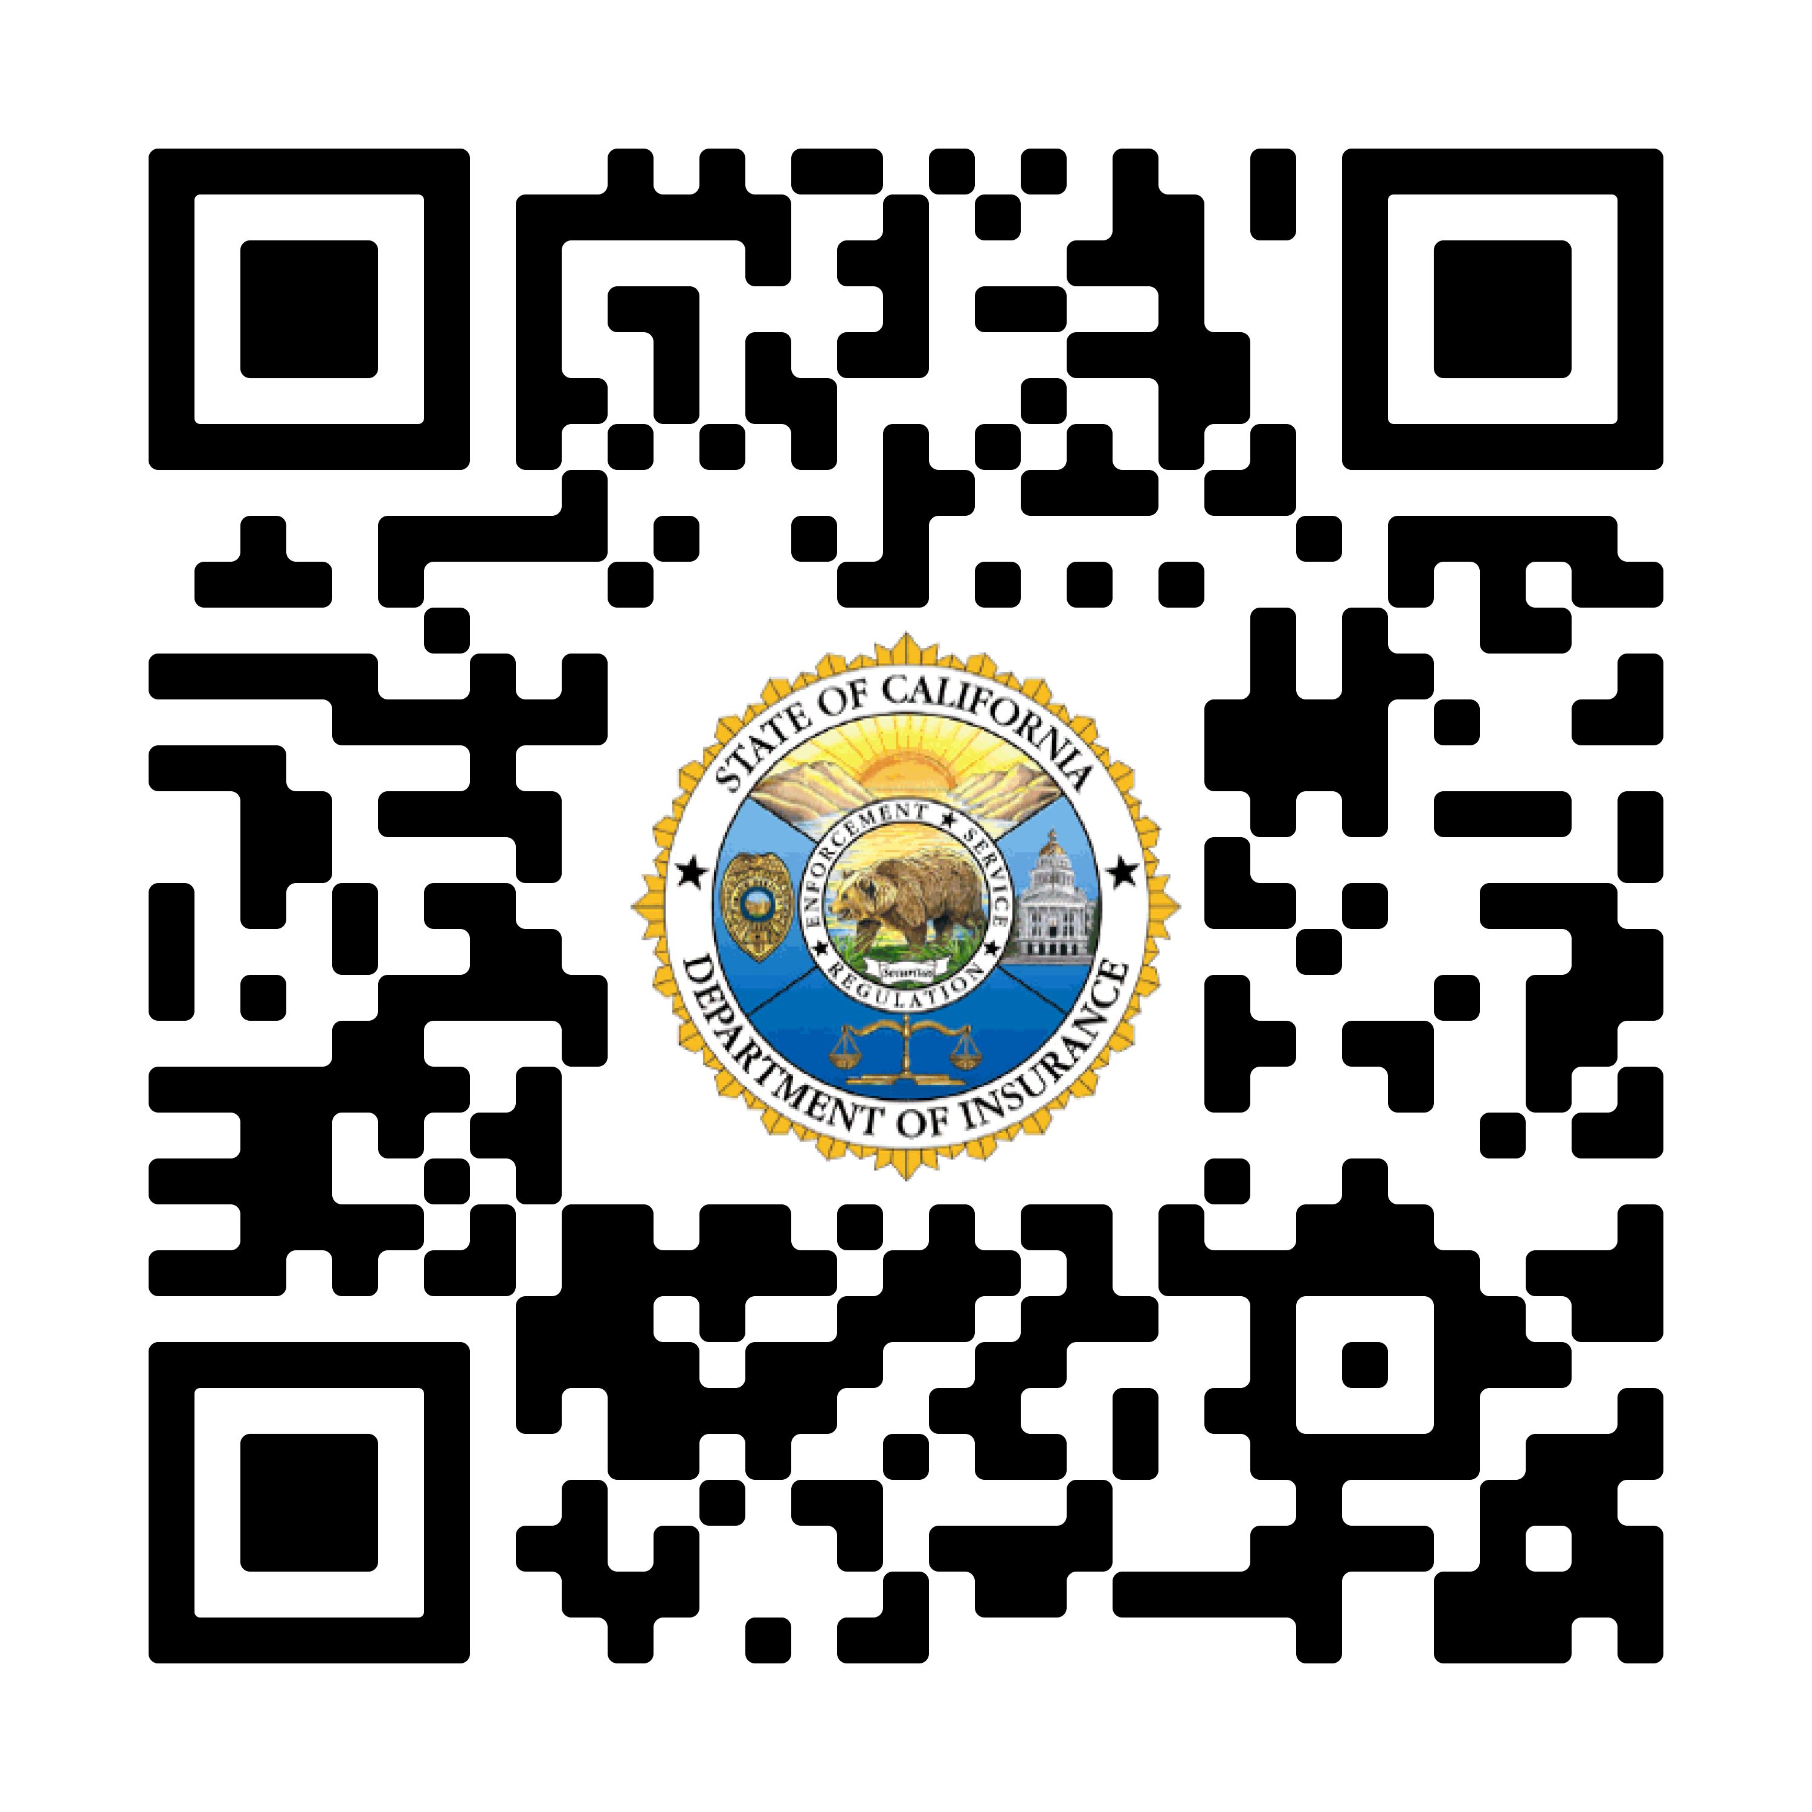
Senior Resources from CDI
Senior Gateway – www.seniors.insurance.ca.gov
One-Stop Website – hosted by CDI
Senior Information Guides
Follow QR Code:

Slide 10
CALIFORNIA DEPARTMENT OF INSURANCE CONTACT INFORMATION
Insurance Questions or Problems
www.insurance.ca.gov
800-927-4357 (HELP)

Slide 11
Presentation Overview
California Department of Insurance (CDI) Overview
What Seniors Need to Know
Common Insurance Scams and Warning Signs
Long Term Care and Annuities
How to Avoid Becoming a Victim
Insurance Fraud Resources & Contacts
Senior Resources
How to Contact Our Department

