Slide 1
Protect Yourself From Fraud
Sally Westlake, Targeted Outreach Specialist

Slide 2
Important Information about this Presentation
The views and opinions expressed in this presentation are those of the presenter. They do not necessarily reflect the views or positions of the DFPI.
This presentation is for educational and informational purposes only. This is not financial advice and does not replace independent or professional judgment.
The DFPI does not assume responsibility for the completeness of the information presented in this presentation.
For more information:
Visit: www.DFPI.ca.gov
Email: Outreach@dfpi.ca.gov

Slide 3
STOP, LOOK & THINK
Before you Click, Tap, Send Money

Slide 4
DEPARTMENT OF
FINANCIAL
PROTECTION & INNOVATION
State licensing and regulatory agency with oversight of state-financial institutions, products, and professionals.
State-chartered Banks & Credit Unions
Residential Mortgage Loan Originators (Servicers)
California Finance Lenders
PACE Administrators
Escrow Agents
Payday Loans
Money Transmitters (PayPal, Zelle, Venmo)
Investment Advisors / Broker Dealers
Franchises
Debt Collectors
Credit Repair Agencies / Consumer Credit Reporting companies
And more.
www.dfpi.ca.gov
866-275-2677

Slide 5
Financial Fraud & Scams Methods of Contact:
Vishing - Telephone (home/cell)
Smishing - Text Messages
Click here
Call back number
Phishing - Computer/Emails

Slide 6
Grandparent/Relative Scam
“Grandpa, I need money for bail…..”
Call and confirm with family members
Set up a family safe word
What will you NOT do?
Wire money, get a prepaid card, or send cryptocurrency or money in any other way.
https://consumer.ftc.gov/features/pass-it-on/impersonator-scams/grandkid-scams

Slide 8
Government/Business Imposter Scams
IMPOSTER
IRS, SSA, Medicare, Utility Company, Financial Institutions
“You owe back taxes. Pay $$$ or get arrested or deported.”
SCAMS
Won’t call, text, or email you out of the blue with threats or promises of money
STOP. Don’t click any links or call numbers
Verify with the “source” AND Do NOT Engage.
What will you NOT do?
Wire money, get a prepaid card, or send cryptocurrency or money in any other way.

Slide 9
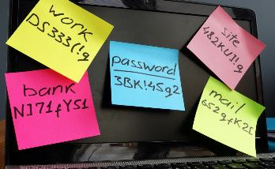
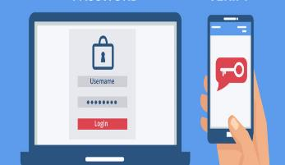
CYBER SAFETY
Passwords
2-Step Verification/MFA
Social Media

Slide 10
What Can You Do?
Never give personal information unless YOU initiated the contact
Unknown calls/numbers – Don’t answer or Hang up!
Don’t return phone calls left on voice message
GOVERNMENT AGENCIES DO NOT CALL
Don’t click on links sent via text/email
Monitor & Freeze Your Credit
Do NOT send money via gift card, wire transfer, cryptocurrency
Verify there is an issue.. GO TO THE SOURCE YOURSELF
Notes:
Go over briefly – NEXT SLIDE

Slide 11
THANK YOU
Contact the DFPI
Learn About Us: https://DFPI.ca.gov
Call Us: (866) 275-2677
Email Us: Ask.DFPI@dfpi.ca.gov
Subscribe to the DFPI Consumer Connection https://dfpi.ca.gov/subscribe/
Please fill out our survey! https://tinyurl.com/dfpisurvey4

Slide 12
STOP, LOOK & THINK
Before you Click, Tap, Send Money!

