Slide 1
Senior Scam Stopper
Mary Le- Special Investigator
October 10, 2024

Slide 2
Agenda
01. BHGS History
02. Electronic and Appliance Repair (EAR)
03. Household Movers (HHM)
A brief history of the Bureau and its three programs, HFTI, EAR & HHM.
Consumer tips for service contracts and obtaining services from an electronic or appliance repair business.
Red flags and consumer tips for obtaining services from a household mover.
04. Home Furnishings and Thermal Insulation (HFTI)
05. Complaints
06. Questions
Overview of HFTI program, including labels, manufacturer requirements and lab testing.
How do I file a complaint? Bureau jurisdiction and limitations commonly seen in complaints filed.
Q&A from attendees

Slide 3
Bureau of Household Goods and Services History
Our Mission: To protect and serve the consumers while ensuring a fair and competitive market
Our Vision: To be an efficient organization that effectively protects consumers and improves the marketplace through enforcement of the law, providing customer service, and prompt licensing
1911
2017
The California Bureau of Home Furnishings and Thermal Insulation (HFTI) was established.
Division of Household Movers was established within the Bureau.
1963
2019
The Bureau of Electronic and Appliance Repair, Home Furnishings and Thermal Insulation became the Bureau of Household Goods and Services.
The California Bureau of Electronic and Appliance Repair (EAR) was established.

Slide 4
Electronic Repairs
Cellphones/Tablets
Computers/Game Consoles
Televisions/Radios
Damaged Screens and Casings
Not Running Properly
Slow Processing
Charging Issues
Runs Slow or Freezes Up
Battery and Power Supply Issues
Video Graphic Issues
Cracked Display or Screen
Power Issues
Screen or Audio Problems
Warranty Work
Car Stereo and Alarm Installation
License
Written Estimate
Invoice
Protect data

Slide 5
Appliance Repairs
Washer & Dryers
Refrigerator & Dishwasher, Etc.
Smaller Appliances
Noisy and Leaking
Clothes not Fully Washed or Dried
Runs Slow or Freezes Up
Ice Maker Problems
Display Screen Malfunction
Dead No Power
Defrost Problems
Motor Spin Cycle Problems
Blenders / Mixers
Microwave Ovens
Cooking Devices
License
Written Estimate
Invoice

Slide 6
Service Contracts
What is a Service Contract?
Understanding the Contract:
Know Your Rights
A written contract covering a specific period to maintain, replace, or repair of an electronic or appliance
What it does and does not cover
When it starts and stops
Liability limits
Your responsibility as a buyer
Review the teams and conditions before you agree to buy
Cancel the contract and receive a full refund within 30 days for home electronics and major appliances
Cancel the contract and receive a pro-rated refund the 30-day period has passed
See the name and address of the party responsible for paying any claims

Slide 7
Know Your Rights- Electronic and Appliance Repair
California law requires that you be given a written estimate, which includes the total price, before the repair.
The service dealer can charge for additional parts or labor if they tell you what the total for the repair will be; they should get your approval.
A service dealer must return all parts, unless they are unsafe or toxic, or rebuilt on an exchange basis, or if you waived having the parts returned.

Slide 8
Household Movers- Beware of Scams
Unpermitted Household Movers
California Law: Household moving companies must be licensed by the Bureau to transport household goods over California roadways.

Slide 9
RED FLAGS to look out for
Misleading website advertisements.
License numbers on website advertisements can be canceled, suspended, revoked, or fraudulent.
Moving trucks that show up on moving day are unmarked.
Movers ask for cash payments or large deposits.
The mover offers an estimate without visually inspecting the goods to be moved.
Contracts and other moving documents are blank or missing information.

Slide 10
Protecting Your Move
Verify the mover’s California permit status on our website: https://bhgs.dca.ca.gov/enforcement/lookup
Contact the Bureau at (916) 999-2041 to check the status of the mover’s California permit.
If you’re moving to a different state, visit the Federal Motor Carrier Safety Administration’s website to get free resources and tools to help you protect yourself from moving fraud. www.fmcsa.dot.gov/protect-your-move

Slide 11
Heading
Bullets

Slide 12
Heading
Bullets

Slide 13
Home Furnishings and Thermal Insulation
Licensing Requirements
Who gets licensed?
Label and State Registry Numbers
Upholstered furniture and bedding must be properly labeled before they can be sold
The registry number identifies the business that manufactured the product and the business location
Disclosed contents
Health issues
Testing and Safety
Routine inspections and sample procurement

Slide 14
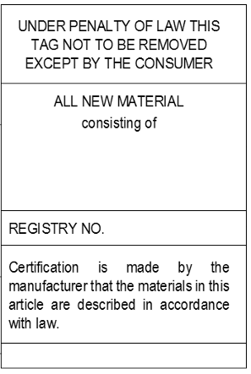
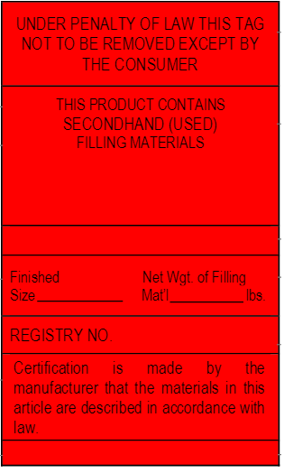
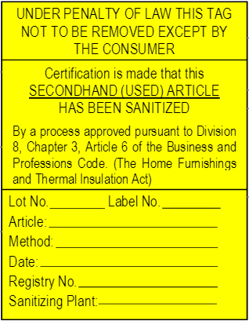
Upholstered Furniture & Bedding Label Requirements

Slide 15
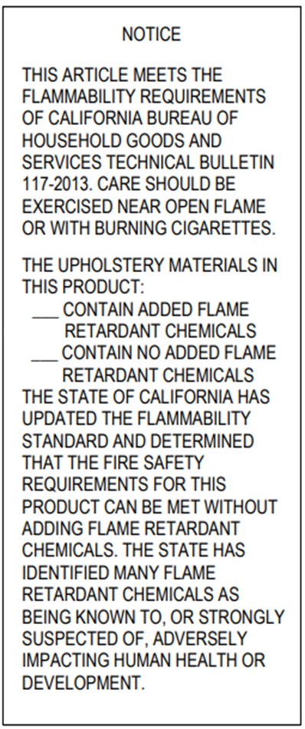
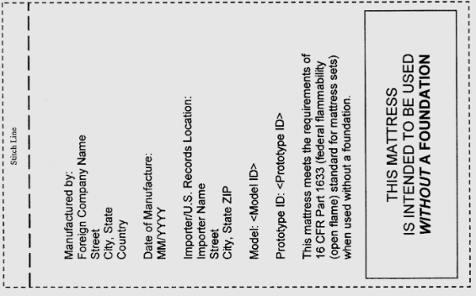
Upholstered Furniture & Bedding Label Requirements Cont.
Mattresses
16 CFR Part 1633 (Federal open flame standard)
Upholstered Furniture
Technical Bulletin 117-2013

Slide 16
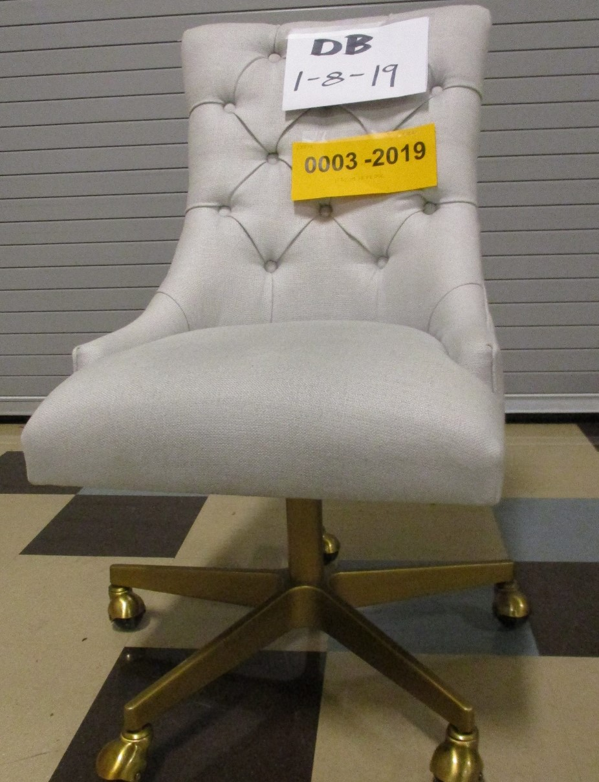
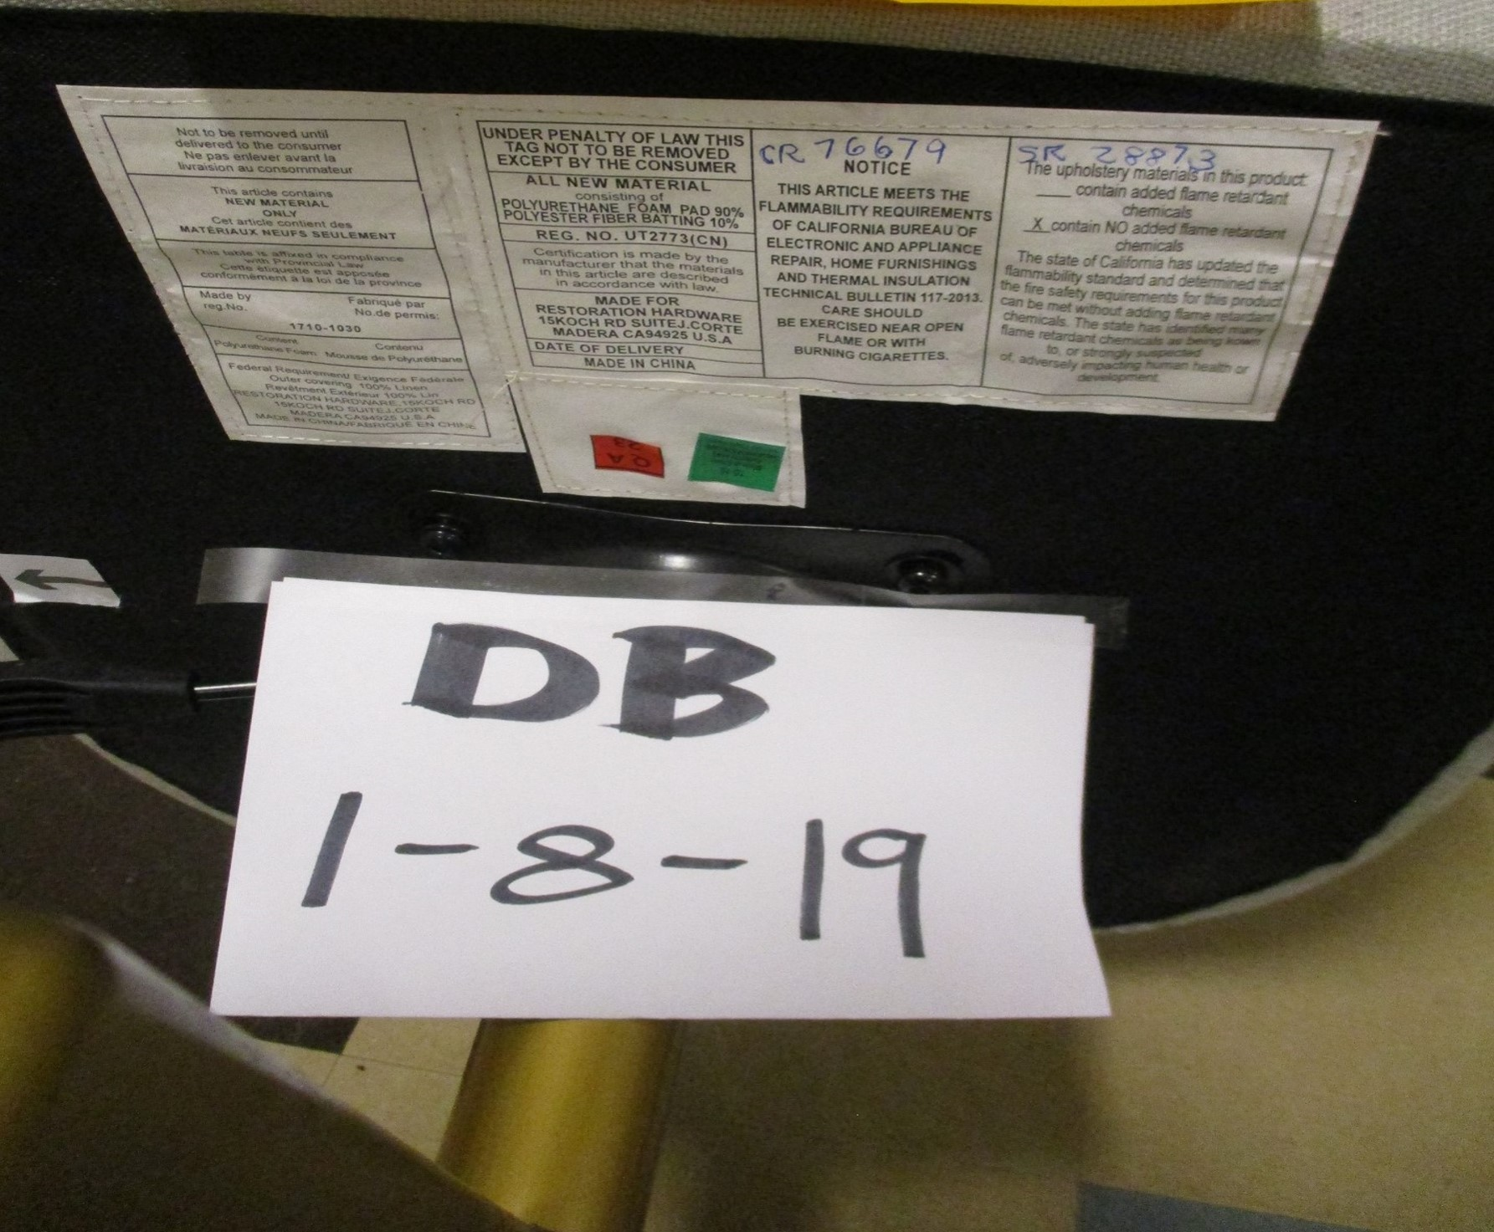
Sample Testing
Heading
Heading
Bullets
Bullets

Slide 17
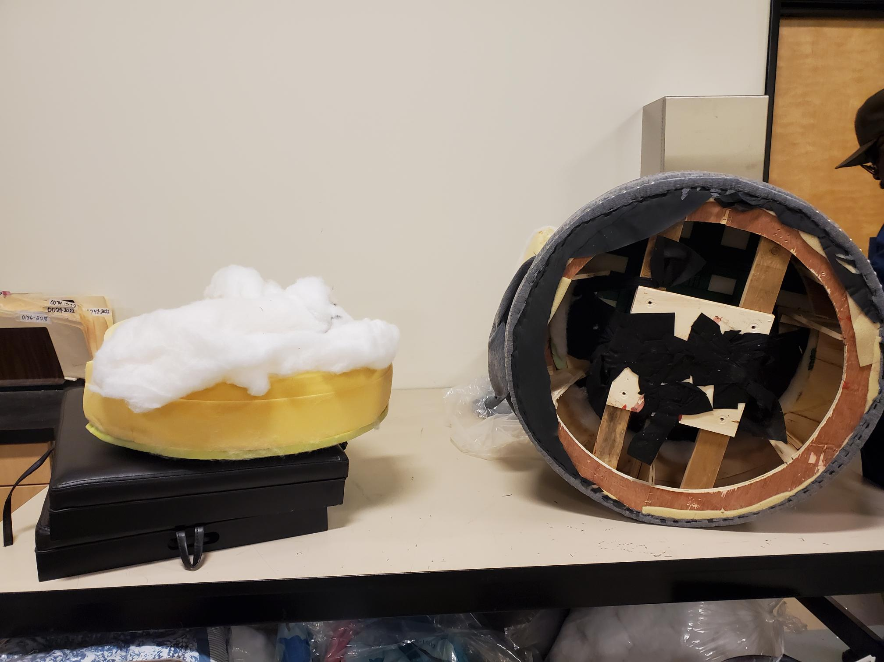
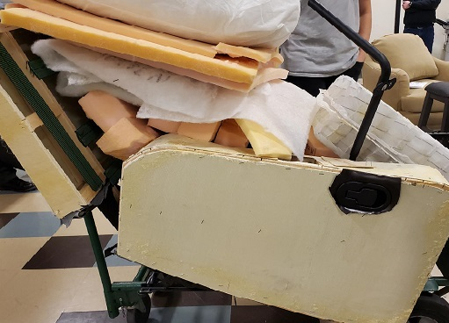
Sample Testing Cont.
Heading
Heading
Bullets
Bullets

Slide 18
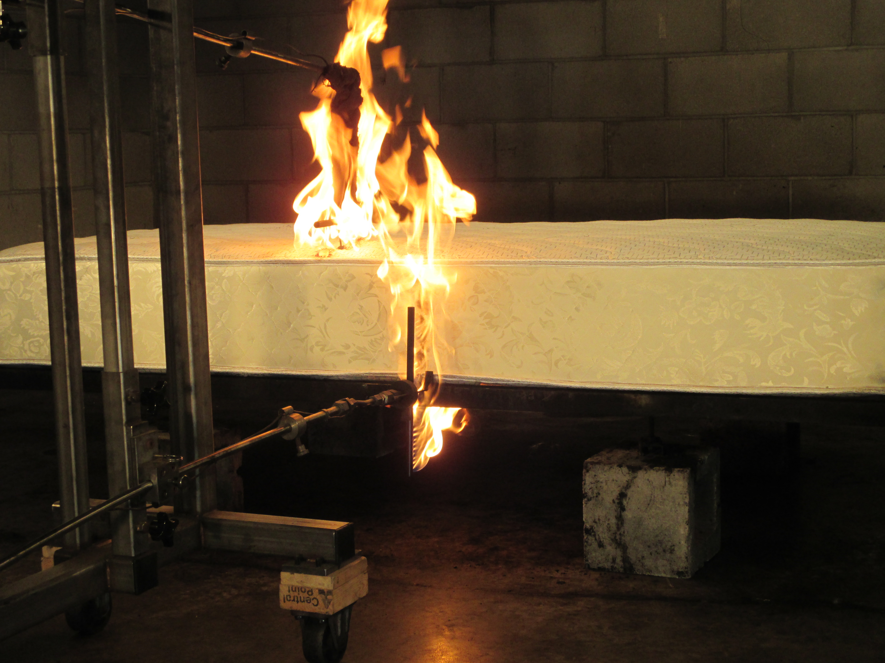
Sample Testing Cont.
Heading
Heading
Bullets
Bullets

Slide 19
Sample Testing Cont.
Heading
Heading
Bullets
Bullets

Slide 20
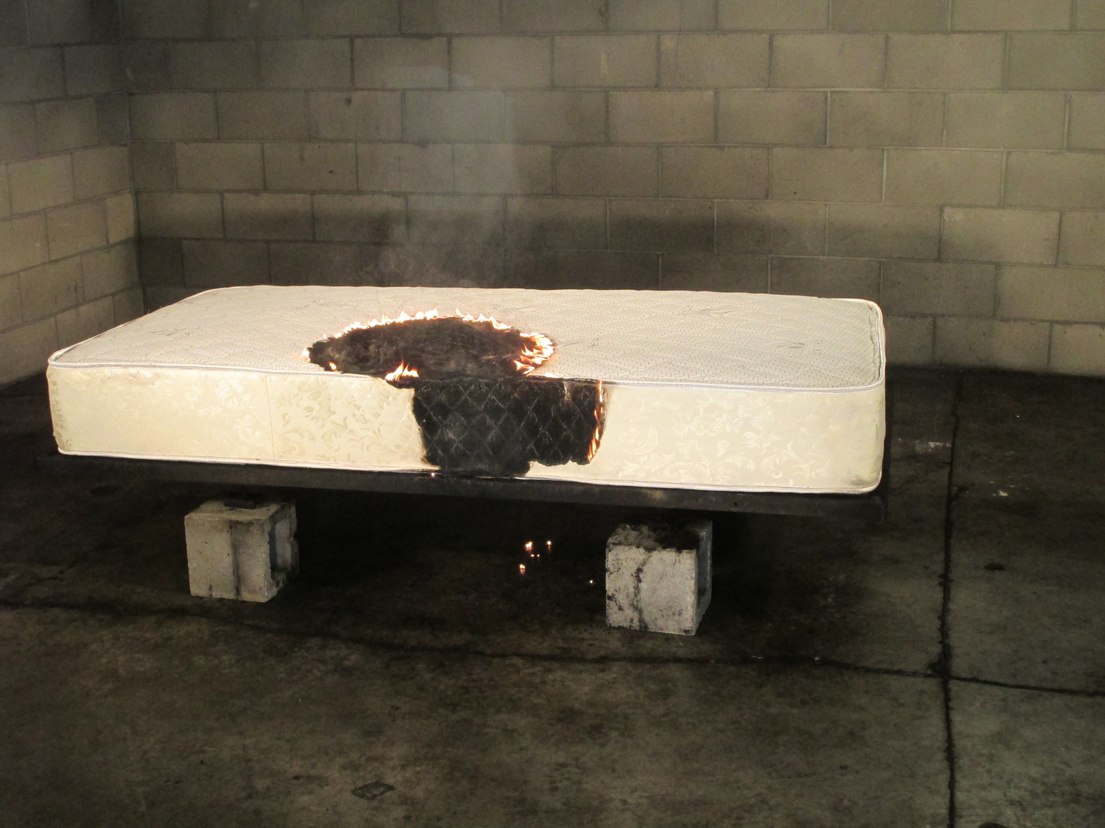
Sample Testing Cont.
Heading
Heading
Bullets
Bullets

Slide 21
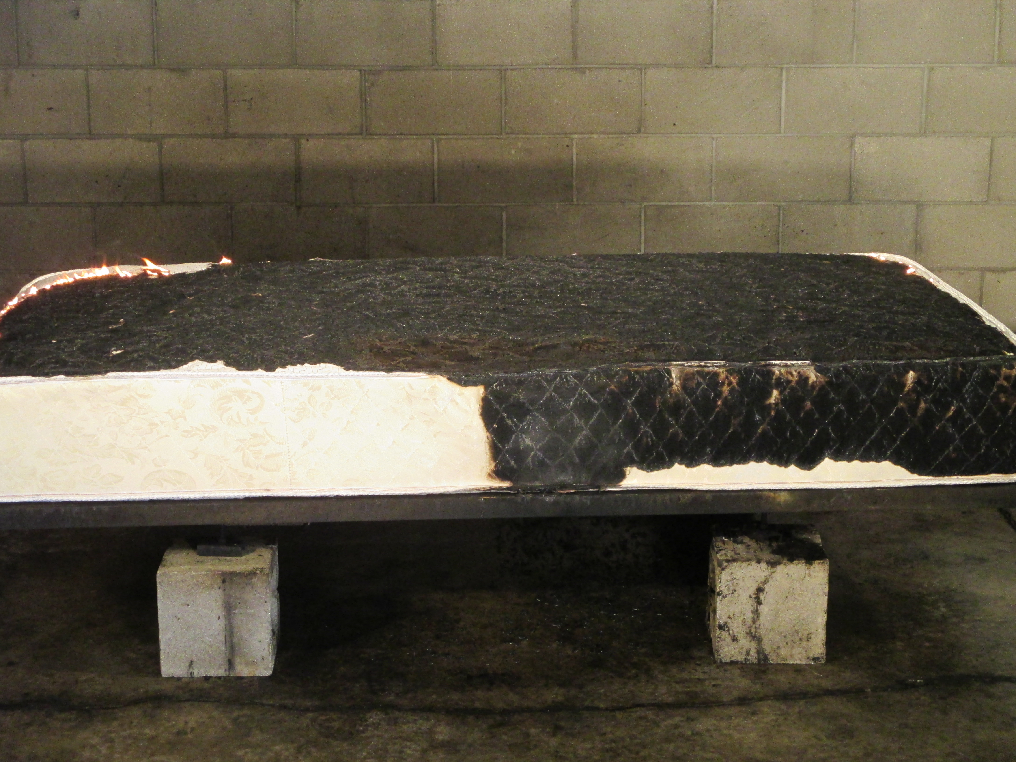
Sample Testing Cont.
Heading
Heading
Bullets
Bullets

Slide 22
Filing a Complaint
Online
Mail/Email
Phone
Consumers can file a complaint online under the “Consumer” tab:
https://bhgs.dca.ca.gov/consumers/index
The printed forms can also be submitted via mail or email:
Bureau of Household Goods and Services 4244 South Market Court, Ste. D Sacramento, CA 95834
HHM - hhm.enf@dca.ca.gov
EAR – bear.enf@dca.ca.gov
HFTI – homeproducts@dca.ca.gov
Consumers can call the Bureau’s and ask to file a complaint via phone.
(916) 999-2041
Option 4 for HHM
Option 5 for EAR or HFTI

Slide 23
Bureau Complaint Jurisdiction
The Bureau only has jurisdiction over a consumer’s personally owned appliances/electronics
The Bureau has no ability to regulate most refunds related to regulated products
Home warranty companies are not regulated by BHGS

Slide 24
Summary
Electronic and Appliance Repair (EAR)
Household Movers (HHM)
Ensure the business is properly licensed with BHGS. Obtain a written estimate prior to repairs beginning and protect your data.
Ensure the business is properly licensed with BHGS. Obtain a visual inspection prior to a written estimate, check the contract for missing information, and retain a complete inventory of your items before the move.
Home Furnishings and Thermal Insulation (HFTI)
Complaints
Ensure the business is properly licensed with BHGS. Check product labeling if issues are suspected.
File a complaint online, via mail, or over the phone. BHGS can only assist with consumer owned property and cannot guarantee a refund will be received.

Slide 25
Contacts for Enforcement
Bureau Chief : Justin Paddock- (916) 217-1696 justin.paddock@dca.ca.gov
Bureau Deputy Chief : Claire Goldstene- (279) 895-1262 claire.goldstene@dca.ca.gov
Enforcement Chief : Alda Aguirre- (714) 625-2570 alda.aguirre@dca.ca.gov

Slide 26
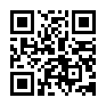
Thank you
Contact Us
Contact BHGS
4244 South Market Court, Ste D Sacramento, CA 95834
Scan QR for all links
Mary Le
Mary.Le@dca.ca.gov
(916) 534-9005
(916) 999-2041
bhgs.dca.ca.gov
facebook.com/CalBHGS
instagram.com/calbhgs
linkedin.com/company/california-bureau-of-household-goods-and-services
twitter.com/CalBHGS
youtube.com/user/californiadca

